Slide 1
Semaphores, Producer Consumer
Operating Systems: Internals and Design Principles
Notes:
“Operating Systems: Internal and Design Principles”, 7/e, by William Stallings, Chapter 5 “Concurrency: Mutual Exclusion and Synchronization”.

Slide 2

Semaphore
There is no way to inspect or manipulate semaphores other than these three operations
A variable that has an integer value upon which only three operations are defined:
May be initialized to a nonnegative integer value
The semWait operation decrements the value
The semSignal operation increments the value
Notes:
The fundamental principle is this: Two or more processes can cooperate by means of simple signals, such that a process can be forced to stop at a specified place until it has received a specific signal. Any complex coordination requirement can be satisfied by the appropriate structure of signals. For signaling, special variables called semaphores are used. To transmit a signal via semaphore s , a process executes the primitive semSignal(s) . To receive a signal via semaphore s , a process executes the primitive semWait(s) ; if the corresponding signal has not yet been transmitted, the process is suspended until the transmission takes place.
To achieve the desired effect, we can view the semaphore as a variable that has an integer value upon which only three operations are defined:
1. A semaphore may be initialized to a nonnegative integer value.
2. The semWait operation decrements the semaphore value. If the value becomes negative, then the process executing the semWait is blocked.
Otherwise, the process continues execution.
3. The semSignal operation increments the semaphore value. If the resulting value is less than or equal to zero, then a process blocked by a semWait operation,
if any, is unblocked. Other than these three operations, there is no way to inspect or manipulate semaphores.
We explain these operations as follows. To begin, the semaphore has a zero or positive value. If the value is positive, that value equals the number of processes that can issue a wait and immediately continue to execute. If the value is zero, either by initialization or because a number of processes equal to the initial semaphore value have issued a wait, the next process to issue a wait is blocked, and the semaphore value goes negative. Each subsequent wait drives the semaphore value further into minus territory. The negative value equals the number of processes waiting to be unblocked. Each signal unblocks one of the waiting processes when the semaphore value is negative.

Slide 3
Consequences
There is no way to know before a process decrements a semaphore whether it will block or not
There is no way to know which process will continue immediately on a uniprocessor system when two processes are running concurrently
You don’t know whether another process is waiting so the number of unblocked processes may be zero or one
Notes:
[DOWN08] points out three interesting consequences of the semaphore definition:
• In general, there is no way to know before a process decrements a semaphore whether it will block or not.
After a process increments a semaphore and another process gets woken up, both processes continue running concurrently. There is no way to know which process, if either, will continue immediately on a uniprocessor system.
• When you signal a semaphore, you don’t necessarily know whether another process is waiting, so the number of unblocked processes may be zero or one.

Slide 4
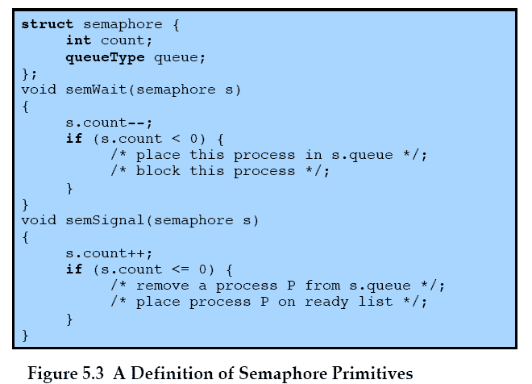
Semaphore Primitives
Notes:
Figure 5.3 suggests a more formal definition of the primitives for semaphores. The semWait and semSignal primitives are assumed to be atomic.

Slide 5
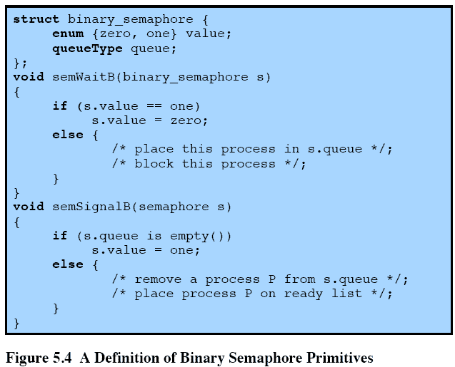
Binary Semaphore Primitives
Notes:
A more restricted version, known as the binary semaphore , is defined in Figure 5.4 . A binary semaphore may only take on the values 0 and 1 and can be defined by the
following three operations:
1. A binary semaphore may be initialized to 0 or 1.
2. The semWaitB operation checks the semaphore value. If the value is zero, then the process executing the semWaitB is blocked. If the value is one, then the value is changed to zero and the process continues execution.
3. The semSignalB operation checks to see if any processes are blocked on this semaphore (semaphore value equals 0). If so, then a process blocked by a semWaitB operation is unblocked. If no processes are blocked, then the value of the semaphore is set to one.
In principle, it should be easier to implement the binary semaphore, and it can be shown that it has the same expressive power as the general semaphore (see Problem 5.17). To contrast the two types of semaphores, the nonbinary semaphore is often referred to as either a counting semaphore or a general semaphore .
A concept related to the binary semaphore is the mutex . A key difference between the two is that the process that locks the mutex (sets the value to zero) must be the one to unlock it (sets the value to 1). In contrast, it is possible for one process to lock a binary semaphore and for another to unlock it.

Slide 6
Strong/Weak Semaphores
A queue is used to hold processes waiting on the semaphore
Strong Semaphores
the process that has been blocked the longest is released from the queue first (FIFO)
Weak Semaphores
the order in which processes are removed from the queue is not specified
Notes:
For both counting semaphores and binary semaphores, a queue is used to hold processes waiting on the semaphore. The question arises of the order in which processes are removed from such a queue. The fairest removal policy is first-in-first-out (FIFO): The process that has been blocked the longest is released from the queue first; a semaphore whose definition includes this policy is called a strong semaphore . A semaphore that does not specify the order in which processes are removed from the queue is a weak semaphore .

Slide 7
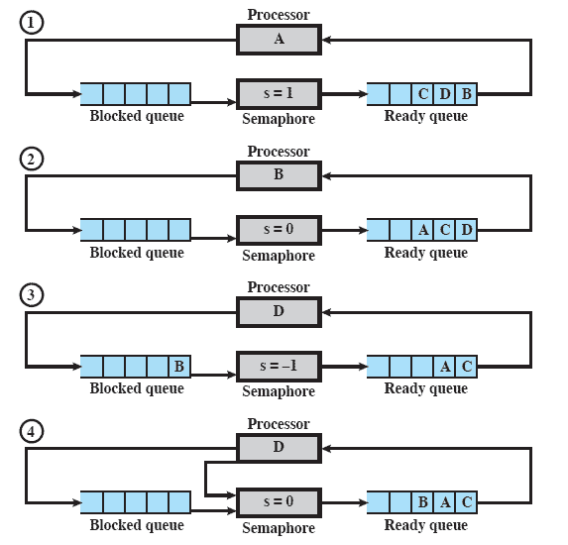
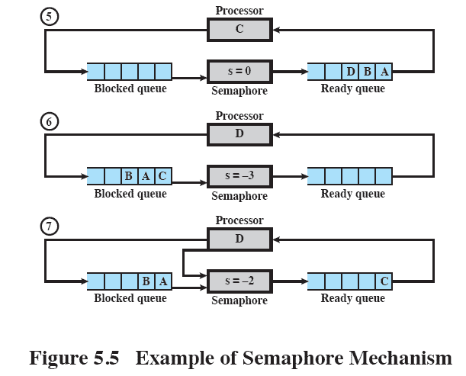
Example of Semaphore Mechanism
Notes:
Figure 5.5 , based on one in [DENN84], is an example of the operation of a strong semaphore. Here processes A, B, and C depend on a result from process D. Initially (1), A is running;
B, C, and D are ready; and the semaphore count is 1, indicating that one of D’s results is available. When A issues a semWait instruction on semaphore s , the semaphore decrements to 0, and A can continue to execute; subsequently it rejoins the ready queue. Then B runs (2), eventually issues a semWait instruction, and is blocked, allowing D to run (3). When D completes a new result, it issues a semSignal instruction, which allows B to move to the ready queue (4). D rejoins the ready queue and C begins to run (5) but is blocked when it issues a semWait instruction. Similarly, A and B run and are blocked on the semaphore, allowing D to resume execution (6). When D has a result, it issues a semSignal , which transfers C to the ready queue. Later cycles of D will release A and B from the Blocked state.

Slide 8
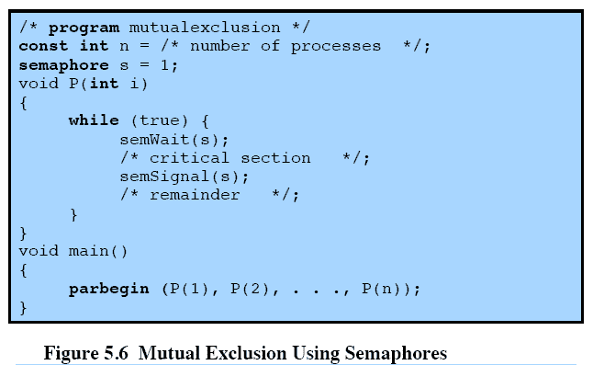
Mutual Exclusion
Notes:
For the mutual exclusion algorithm discussed in the next subsection and illustrated in Figure 5.6 , strong semaphores guarantee freedom from starvation, while weak semaphores do not. We will assume strong semaphores because they are more convenient and because this is the form of semaphore typically provided by operating systems.
Figure 5.6 shows a straightforward solution to the mutual exclusion problem using a semaphore s (compare Figure 5.1 ). Consider n processes, identified in the array P ( i ), all of which need access to the same resource. Each process has a critical section used to access the resource. In each process, a semWait(s) is executed just before its critical section. If the value of s becomes negative, the process is blocked. If the value is 1, then it is decremented to 0 and the process immediately enters its critical section; because s is no longer positive, no other process will be able to enter its critical section.
The semaphore is initialized to 1. Thus, the first process that executes a semWait will be able to enter the critical section immediately, setting the value of s to 0. Any other process attempting to enter the critical section will find it busy and will be blocked, setting the value of s to –1. Any number of processes may attempt entry; each such unsuccessful attempt results in a further decrement of the value of s . When the process that initially entered its critical section departs, s is incremented and one of the blocked processes (if any) is removed from the queue of blocked processes associated with the semaphore and put in a Ready state. When it is next scheduled by the OS, it may enter the critical section.

Slide 9
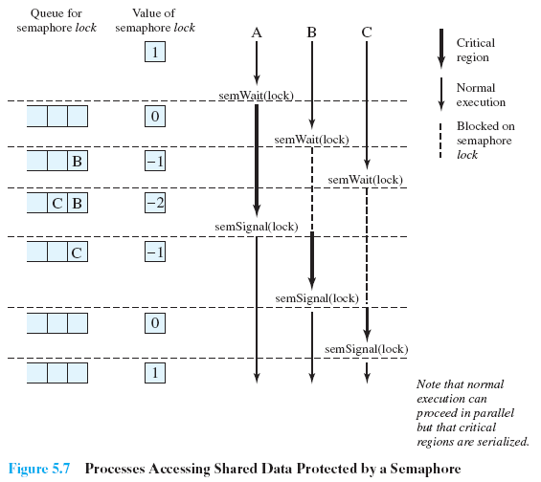

Shared Data Protected by a Semaphore
Notes:
Figure 5.7 , based on one in [BACO03], shows a possible sequence for three processes using the mutual exclusion discipline of Figure 5.6 . In this example three processes (A, B, C) access a shared resource protected by the semaphore lock . Process A executes semWait( lock ) ; because the semaphore has a value of 1 at the time of the semWait operation, A can immediately enter its critical section and the semaphore takes on the value 0. While A is in its critical section, both B and CFigure 5.7 , based on one in [BACO03], shows a possible sequence for three processes using the mutual exclusion discipline of Figure 5.6 . In this example three processes (A, B, C) access a shared resource protected by the semaphore lock .
Process A executes semWait( lock ) ; because the semaphore has a value of 1 at the time of the semWait operation, A can immediately enter its critical section and the semaphore takes on the value 0. While A is in its critical section, both B and C perform a semWait operation and are blocked pending the availability of the semaphore. When A exits its critical section and performs semSignal( lock ) , B, which was the first process in the queue, can now enter its critical section.

Slide 10
Producer/Consumer Problem
General Situation:
one or more producers are generating data and placing these in a buffer
a single consumer is taking items out of the buffer one at time
only one producer or consumer may access the buffer at any one time
The Problem:
ensure that the producer can’t add data into full buffer and consumer can’t remove data from an empty buffer
Notes:
To begin, let us assume that the buffer is infinite and consists of a linear array of elements.
We now examine one of the most common problems faced in concurrent processing: the producer/consumer problem. The general statement is this: There are one or more producers generating some type of data (records, characters) and placing these in a buffer. There is a single consumer that is taking items out of the buffer one at a time. The system is to be constrained to prevent the overlap of buffer operations. That is, only one agent (producer or consumer) may access the buffer at any one time. The problem is to make sure that the producer won’t try to add data into the buffer if it’s full and that the consumer won’t try to remove data from an empty buffer. We will look at a number of solutions to this problem to illustrate both the power and the pitfalls of semaphores.

Slide 11
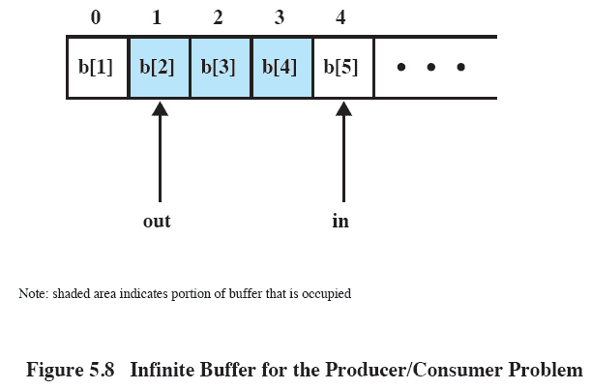
Buffer Structure
Notes:
Figure 5.8 illustrates the structure of buffer b . The producer can generate items and store them in the buffer at its own pace. Each time, an index ( in ) into the buffer is incremented. The consumer proceeds in a similar fashion but must make sure that it does not attempt to read from an empty buffer. Hence, the consumer makes sure that the producer has advanced beyond it ( in > out ) before proceeding.

Slide 12
Implementation of Semaphores
Imperative that the semWait and semSignal operations be implemented as atomic primitives
Can be implemented in hardware or firmware
Software schemes such as Dekker’s or Peterson’s algorithms can be used
Use one of the hardware-supported schemes for mutual exclusion
Notes:
As was mentioned earlier, it is imperative that the semWait and semSignal operations be implemented as atomic primitives. One obvious way is to implement them in hardware or firmware. Failing this, a variety of schemes have been suggested. The essence of the problem is one of mutual exclusion: Only one process at a time may manipulate a semaphore with either a semWait or semSignal operation. Thus, any of the software schemes, such as Dekker’s algorithm or Peterson’s algorithm ( Appendix A ), could be used; this would entail a substantial processing overhead.
Another alternative is to use one of the hardware-supported schemes for mutual exclusion.

Slide 13

Monitors
Programming language construct that provides equivalent functionality to that of semaphores and is easier to control
Implemented in a number of programming languages
including Concurrent Pascal, Pascal-Plus, Modula-2, Modula-3, and Java
Has also been implemented as a program library
Software module consisting of one or more procedures, an initialization sequence, and local data
Notes:
The monitor is a programming-language construct that provides equivalent functionality to that of semaphores and that is easier to control. The concept was first formally defined in [HOAR74]. The monitor construct has been implemented in a number of programming languages, including Concurrent Pascal, Pascal-Plus, Modula-2, Modula-3, and Java. It has also been implemented as a program library. This allows programmers to put a monitor lock on any object. In particular, for something like a linked list, you may want to lock all linked lists with one lock, or have one lock for each list, or have one lock for each element of each list.
A monitor is a software module consisting of one or more procedures, an initialization sequence, and local data.

Slide 14
Monitor Characteristics
Local data variables are accessible only by the monitor’s procedures and not by any external procedure
Process enters monitor by invoking one of its procedures
Only one process may be executing in the monitor at a time
Notes:
The chief characteristics of a monitor are the following:
1. The local data variables are accessible only by the monitor’s procedures and
not by any external procedure.
2. A process enters the monitor by invoking one of its procedures.
3. Only one process may be executing in the monitor at a time; any other processes
that have invoked the monitor are blocked, waiting for the monitor to become available.
The first two characteristics are reminiscent of those for objects in object-oriented software. Indeed, an object-oriented OS or programming language can readily implement a monitor as an object with special characteristics.
By enforcing the discipline of one process at a time, the monitor is able to provide a mutual exclusion facility. The data variables in the monitor can be accessed by only one process at a time. Thus, a shared data structure can be protected by placing it in a monitor. If the data in a monitor represent some resource, then the monitor provides a mutual exclusion facility for accessing the resource.
To be useful for concurrent processing, the monitor must include synchronization tools. For example, suppose a process invokes the monitor and, while in the
monitor, must be blocked until some condition is satisfied. A facility is needed by which the process is not only blocked but releases the monitor so that some other process may enter it. Later, when the condition is satisfied and the monitor is again available, the process needs to be resumed and allowed to reenter the monitor at the point of its suspension.

Slide 15
Readers/Writers Problem
A data area is shared among many processes
some processes only read the data area, (readers) and some only write to the data area (writers)
Conditions that must be satisfied:
any number of readers may simultaneously read the file
only one writer at a time may write to the file
if a writer is writing to the file, no reader may read it
Notes:
The readers/writers problem is defined as follows: There is a data area shared among a number of processes. The data area could be a file, a block of main memory, or even a bank of processor registers. There are a number of processes that only read the data area (readers) and a number that only write to the data area (writers). The conditions that must be satisfied are as follows:
1. Any number of readers may simultaneously read the file.
2. Only one writer at a time may write to the file.
3. If a writer is writing to the file, no reader may read it.
Thus, readers are processes that are not required to exclude one another and writers are processes that are required to exclude all other processes, readers and writers alike.

Slide 16
Summary
Messages
Operating system themes are:
Mutual Exclusion
Useful for the enforcement of mutual exclusion discipline
Multiprogramming, multiprocessing, distributed processing
Fundamental to these themes is concurrency
issues of conflict resolution and cooperation arise
Condition in which there is a set of concurrent processes, only one of which is able to access a given resource or perform a given function at any time
One approach involves the use of special purpose machine instructions
Semaphores
Used for signaling among processes and can be readily used to enforce a mutual exclusion discipline
Notes:
Chapter 5 Summary.

